Slide 1
MASTERPIECES OF WESTERN ART Art Humanities W1121 Section 15
Raphael
(Part 2)

Slide 2
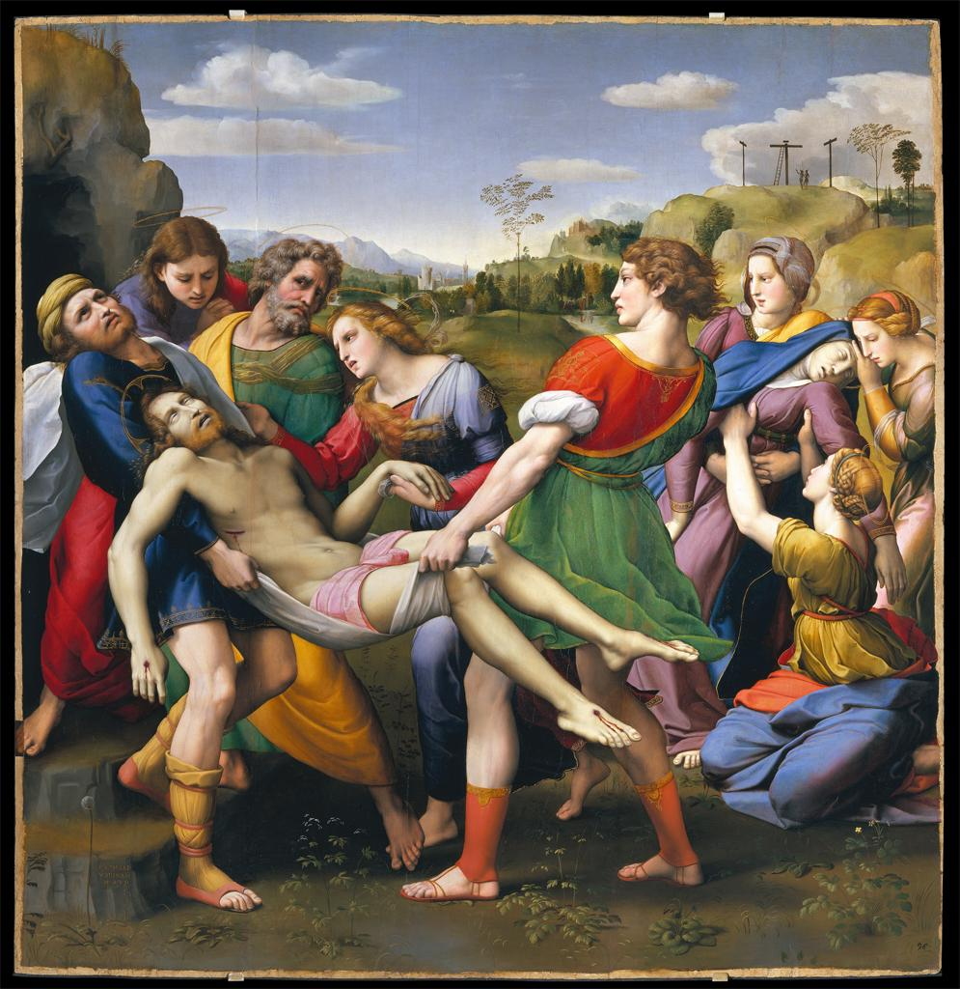
Raphael, Entombment, 1507

Slide 3
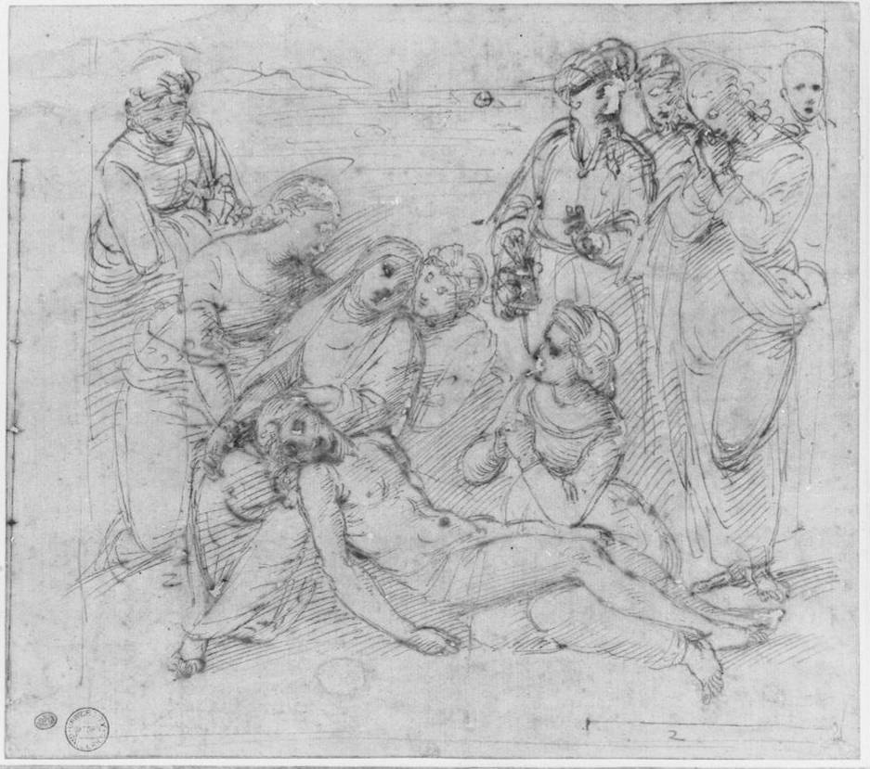
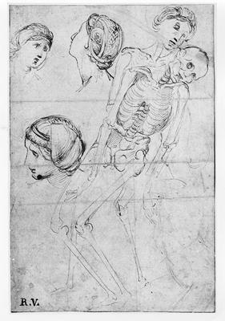
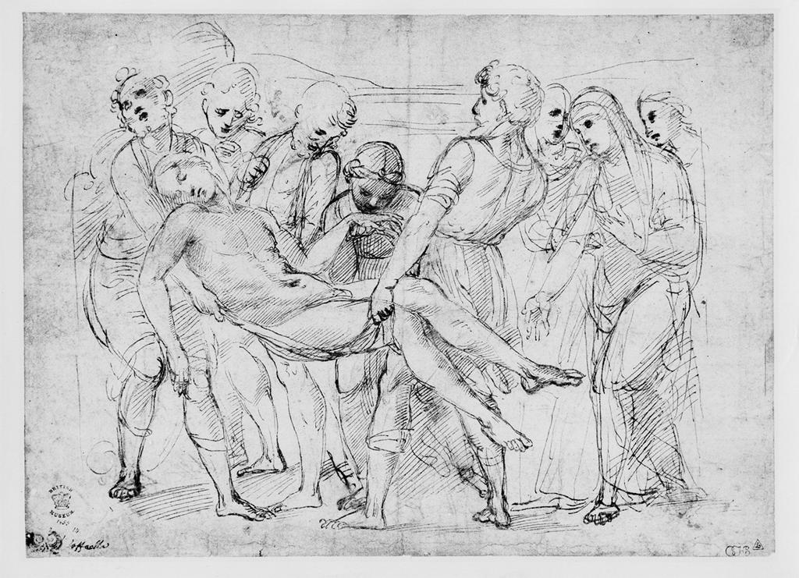
Raphael, Three studies for The Entombment

Slide 4
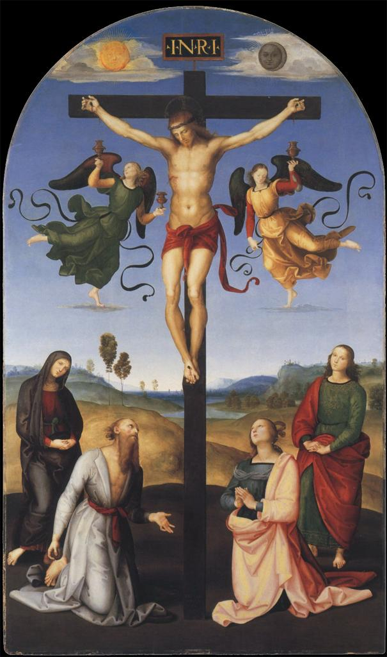

Slide 5
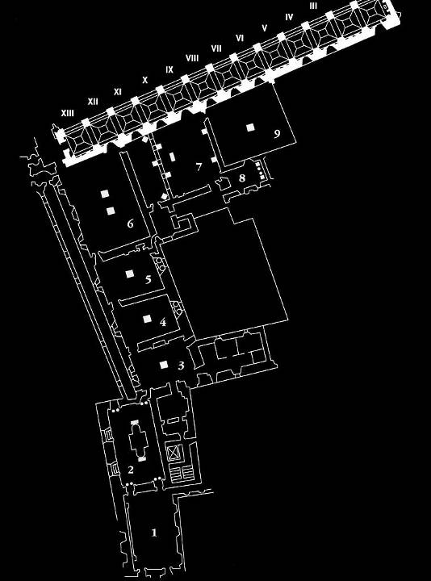
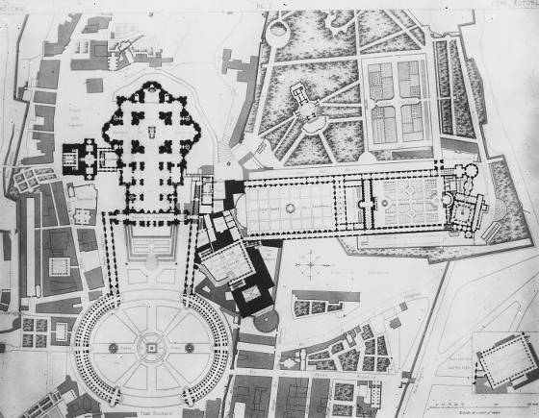
Plan of the Papal Apartments
(4) Stanza della Segnatura
Plan of the Vatican

Slide 6
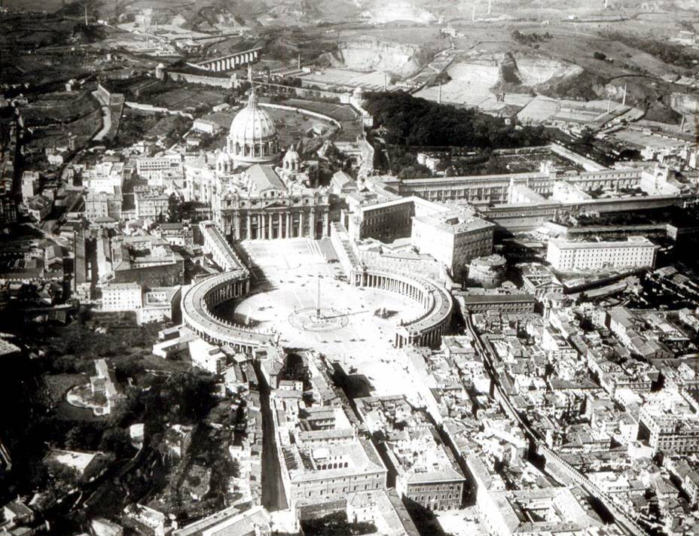
Rome, the Vatican

Slide 7
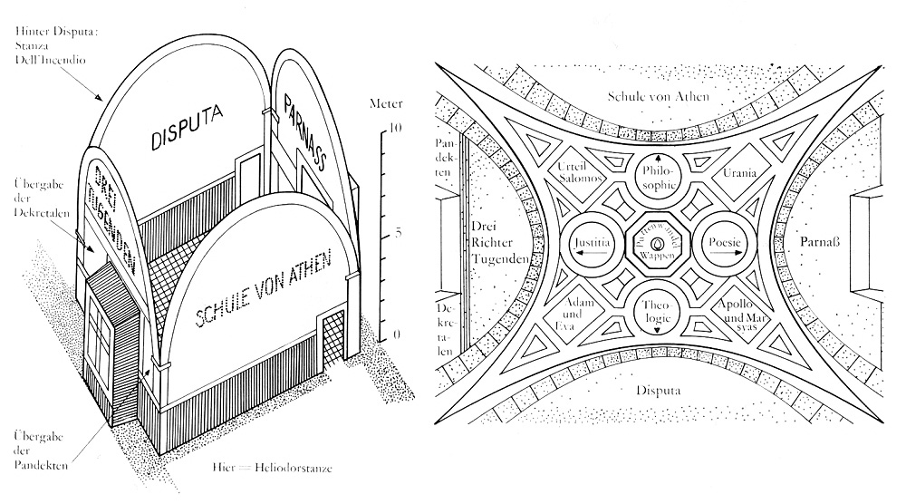
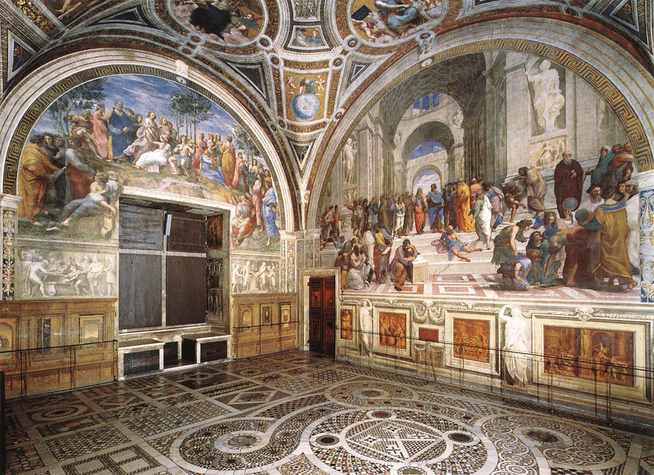
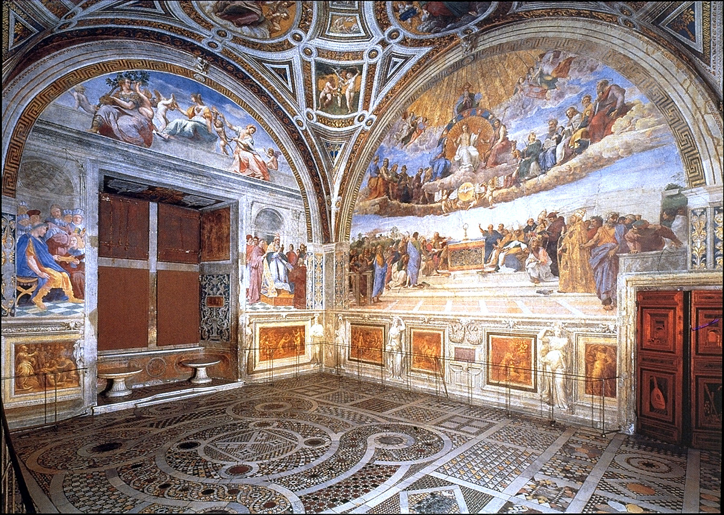
Raphael, Stanza della Segnatura, 1508-12

Slide 8
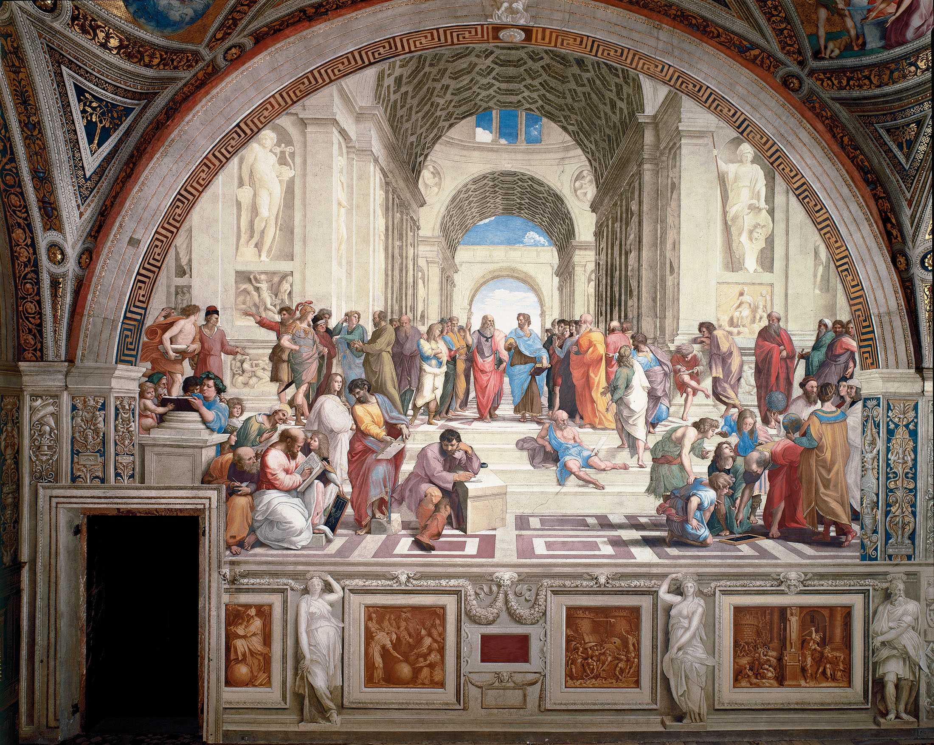
School of Athens (Philosophy)

Slide 9
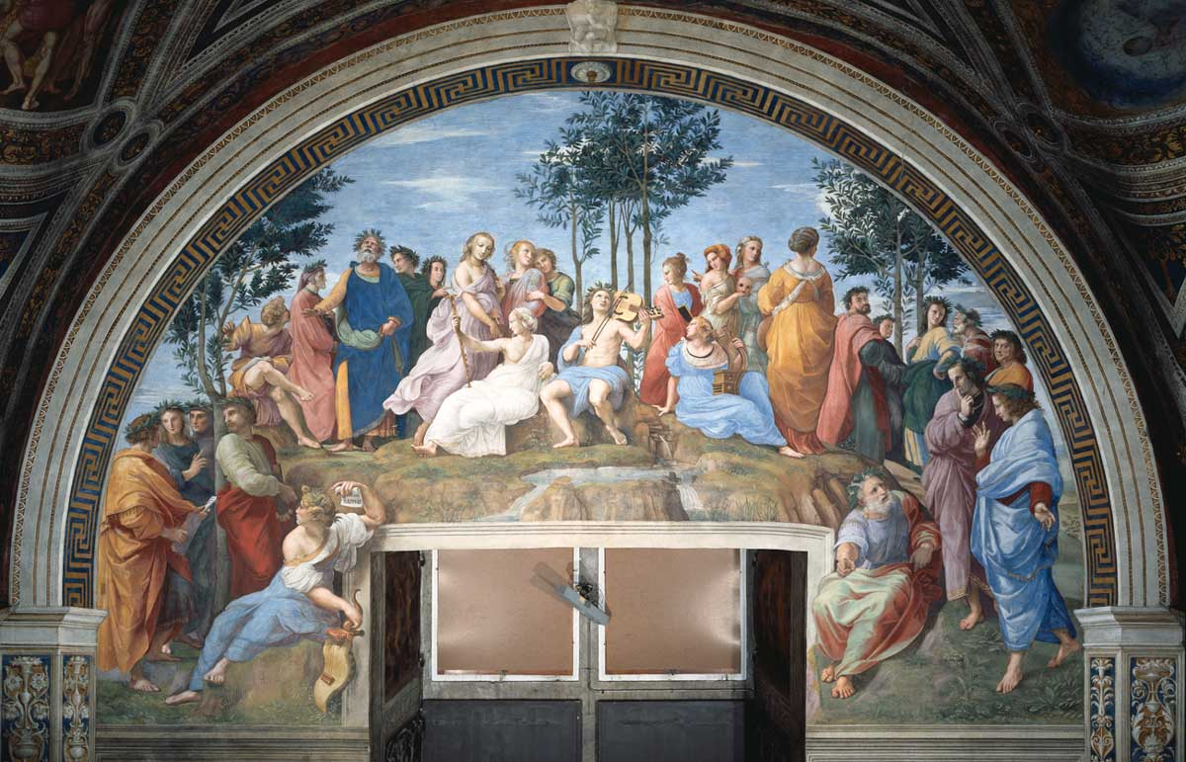
Parnassus (Poetry)

Slide 10
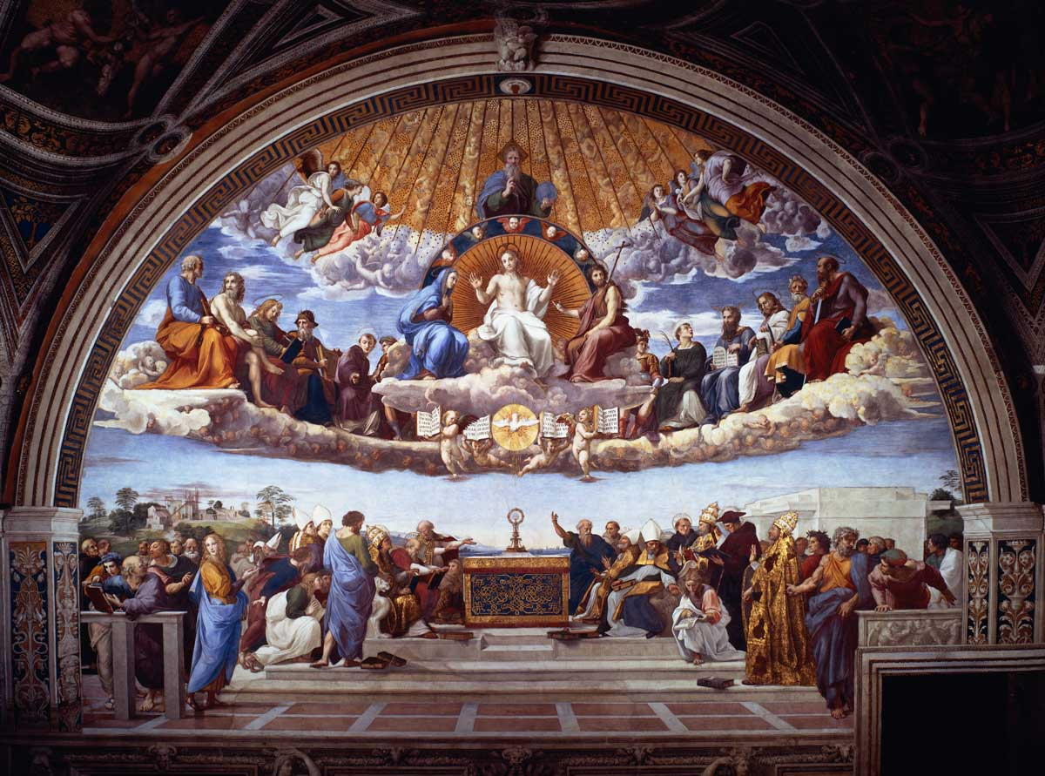
Disputa (Theology)

Slide 11
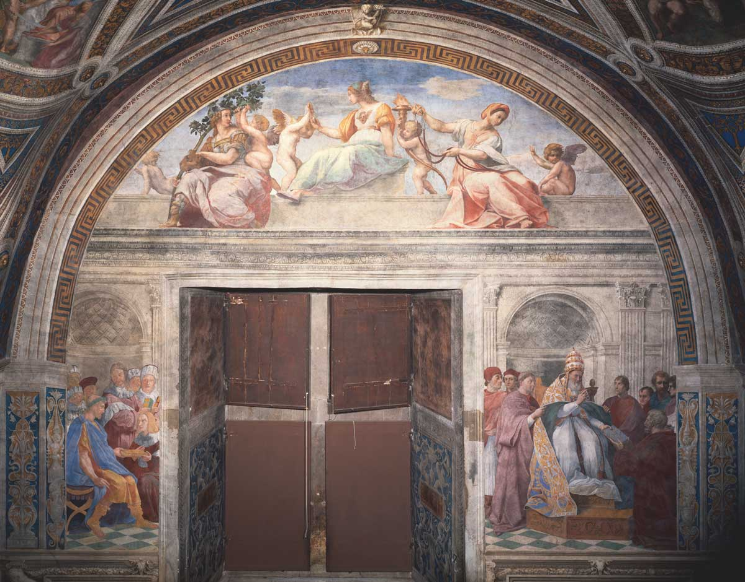
Jurisprudence (Law)

Slide 12
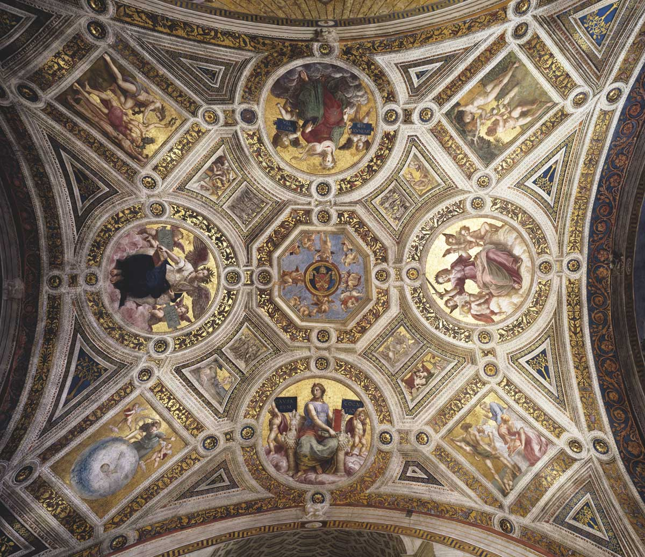
Vault: general view

Slide 13
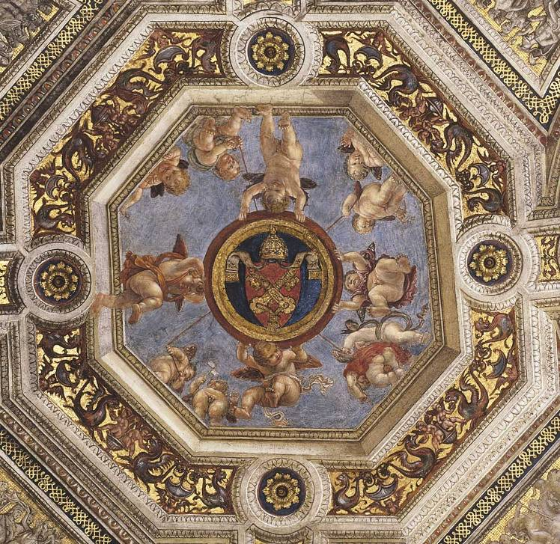
The Papal Arms

Slide 14
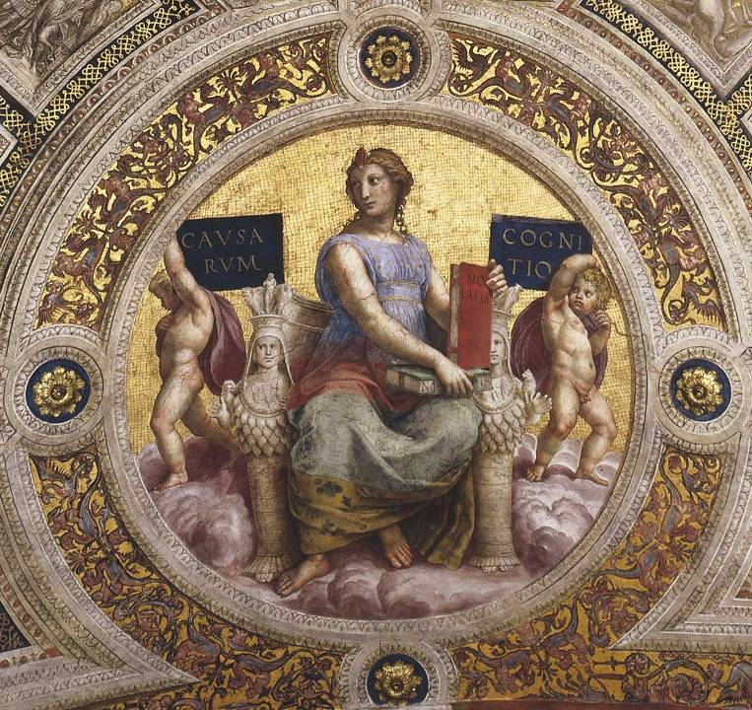
Philosophy

Slide 15
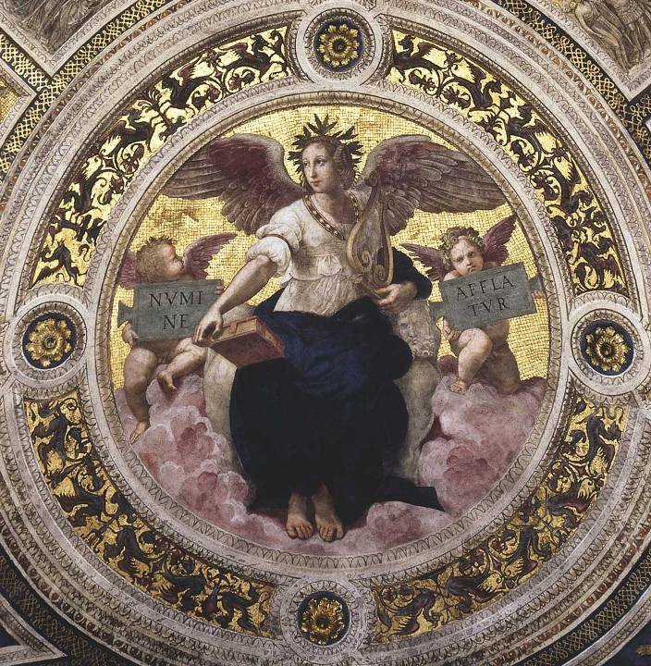
Poetry

Slide 16
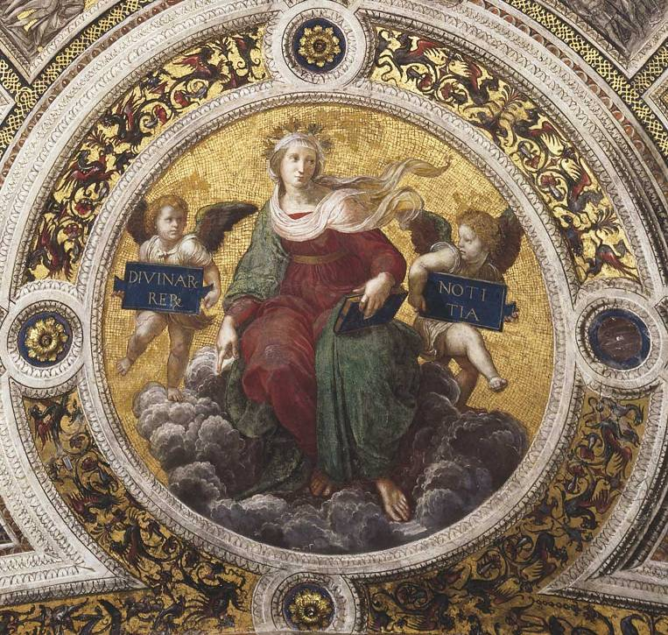
Theology

Slide 17
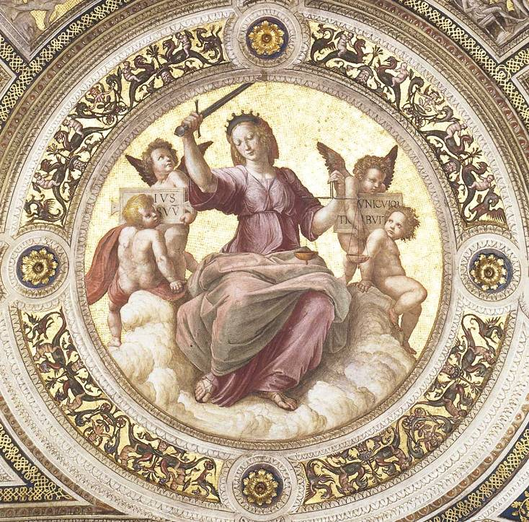
Jurisprudence

Slide 18
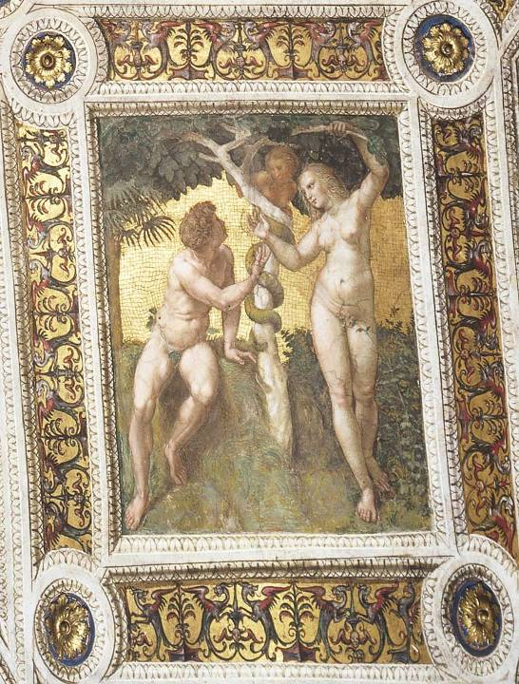
Adam and Eve

Slide 19
School of Athens (Philosophy)

Slide 20
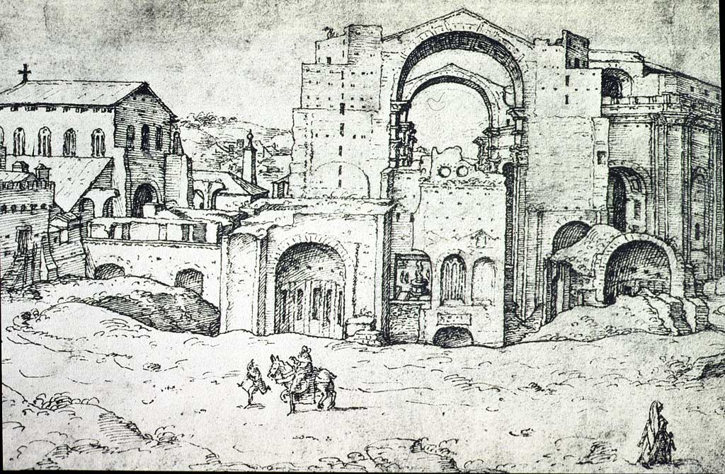
Maarten van Heemskerck
St. Peter’s Basilica under construction
Drawing, mid-16th century

Slide 21
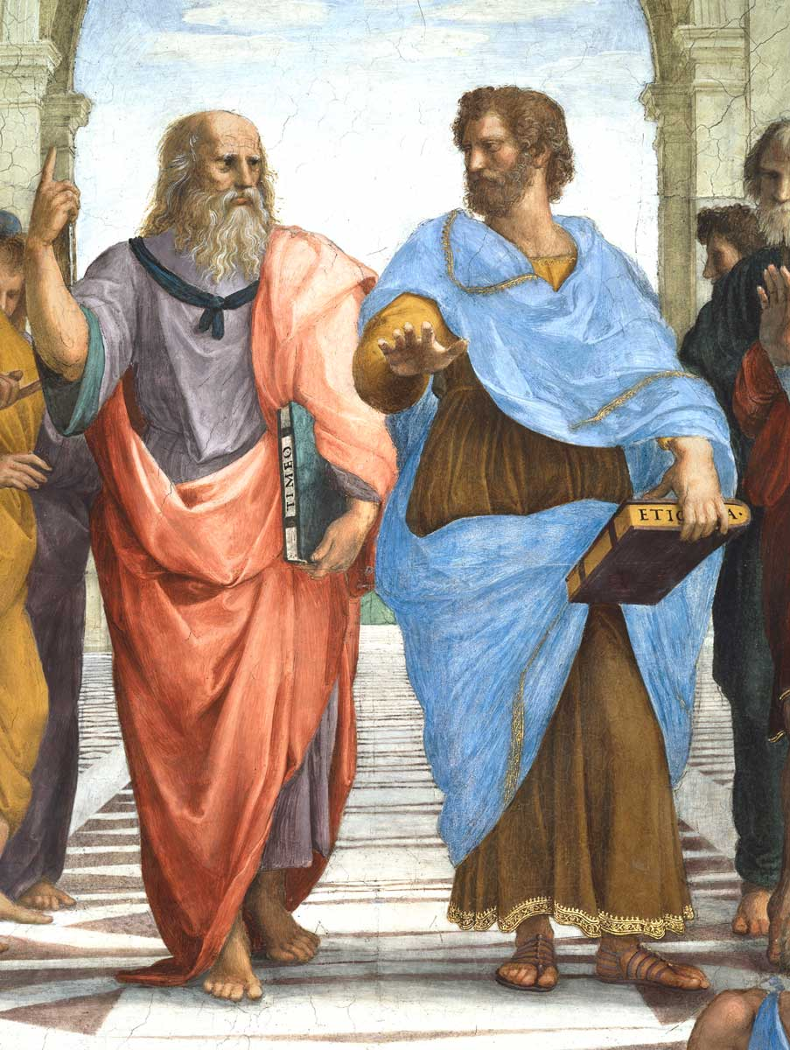

Slide 22
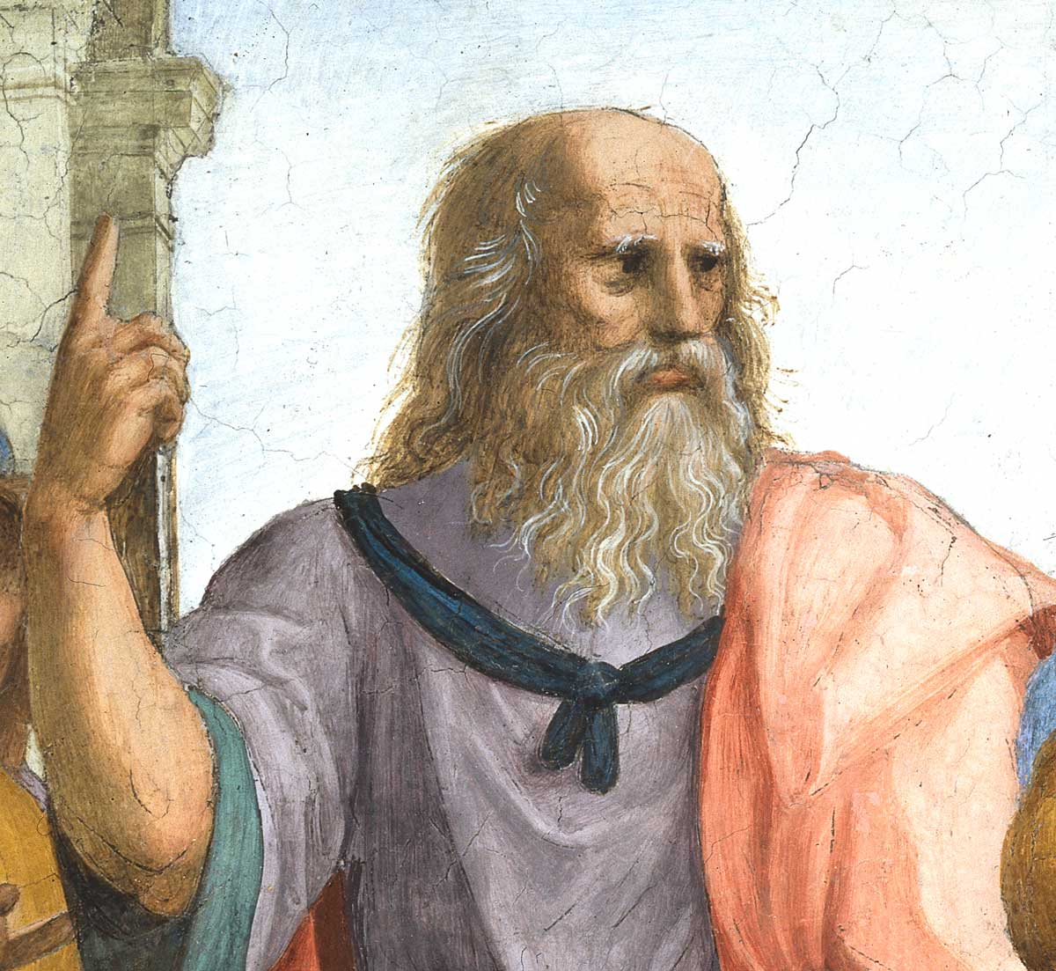
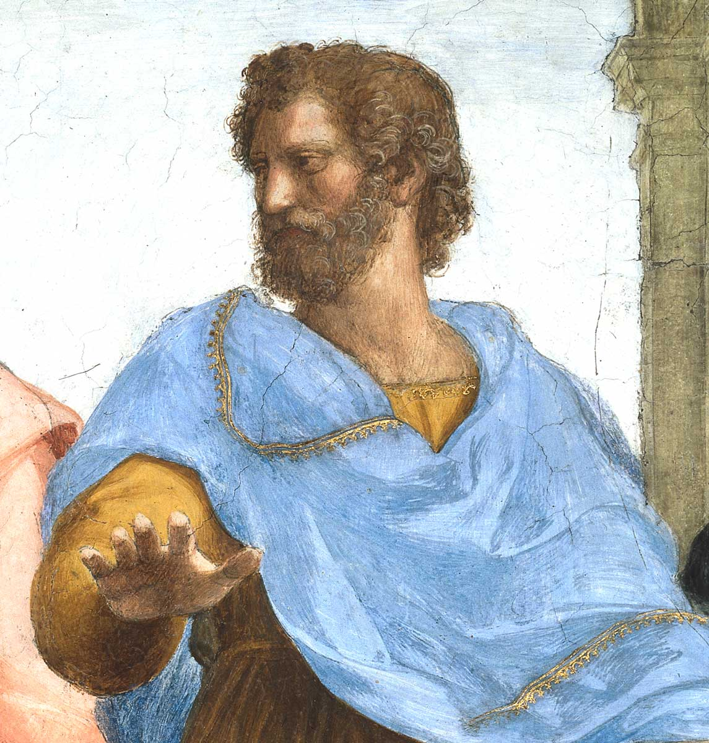

Slide 23
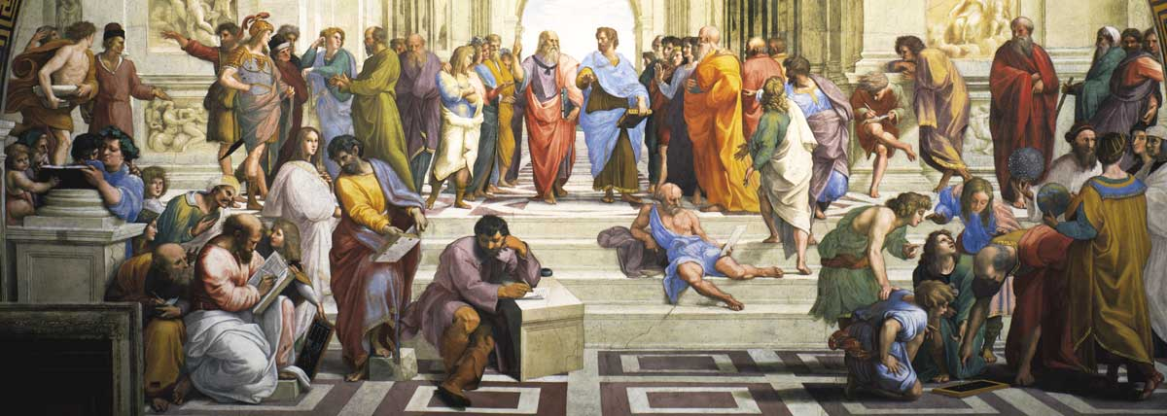

Slide 24
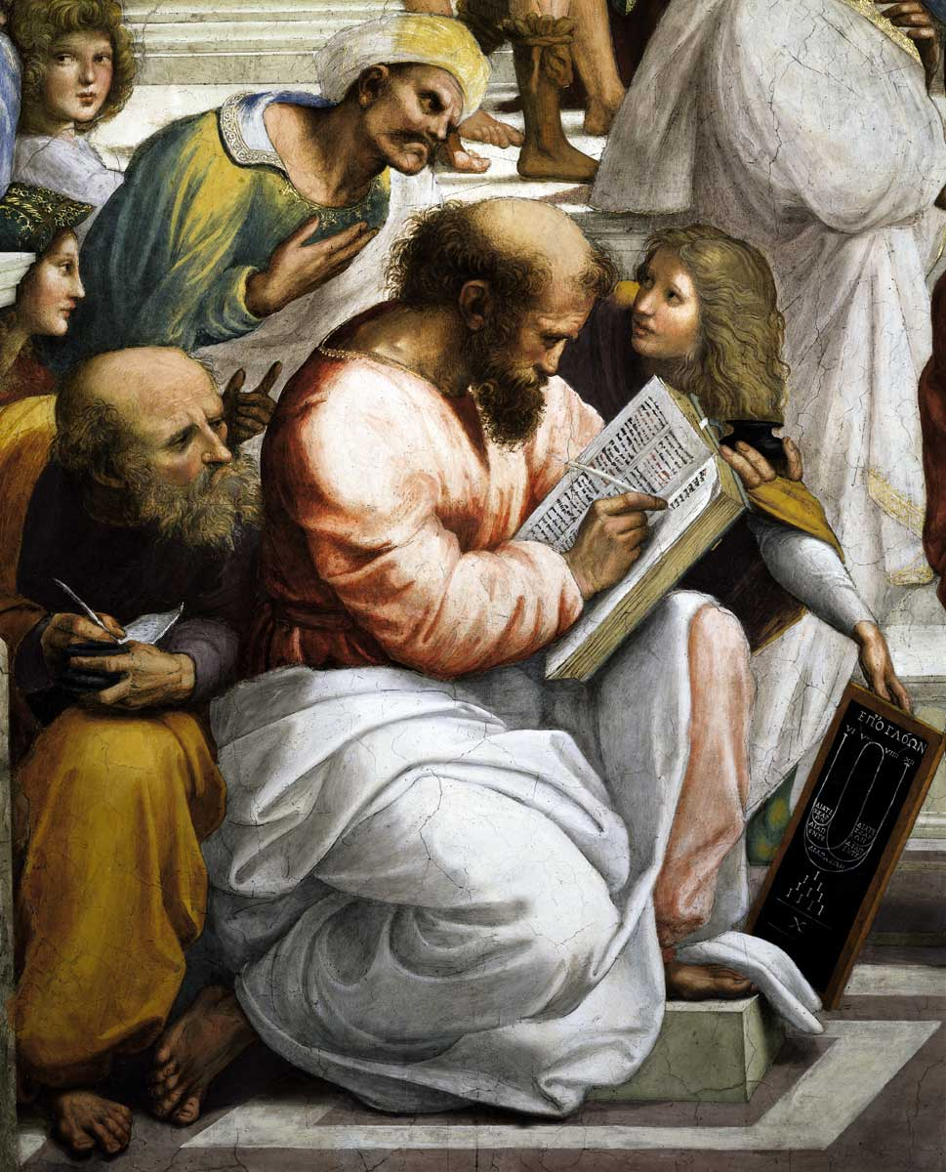
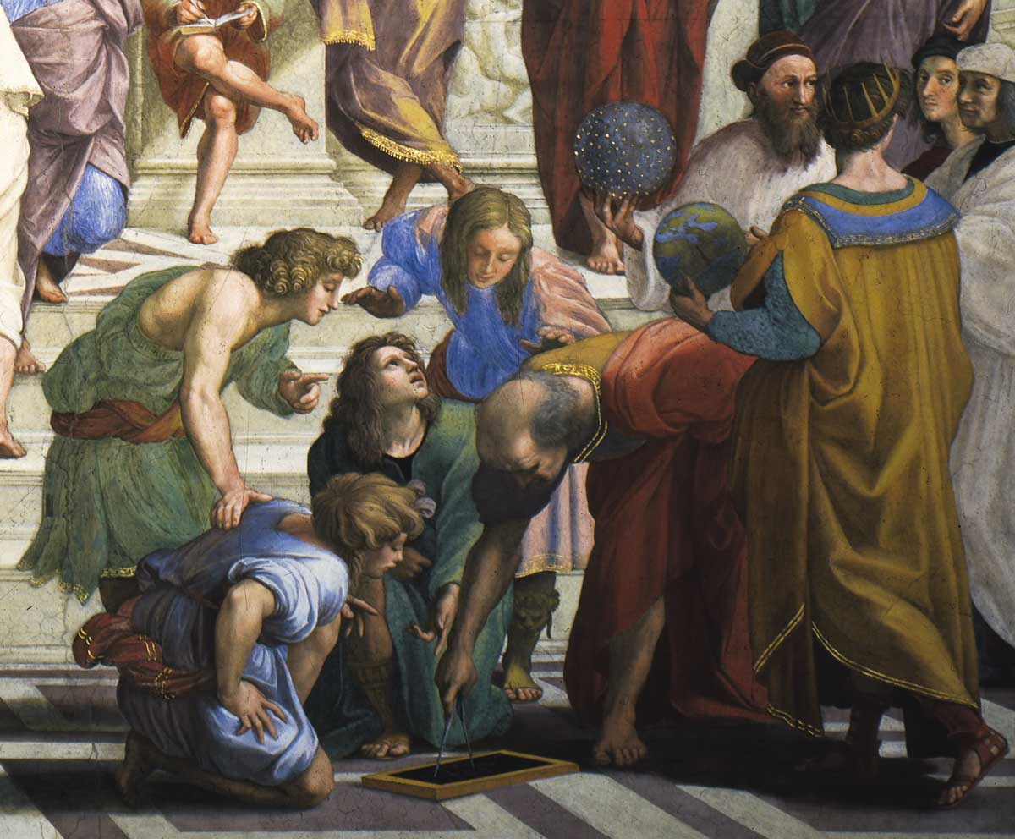

Slide 25
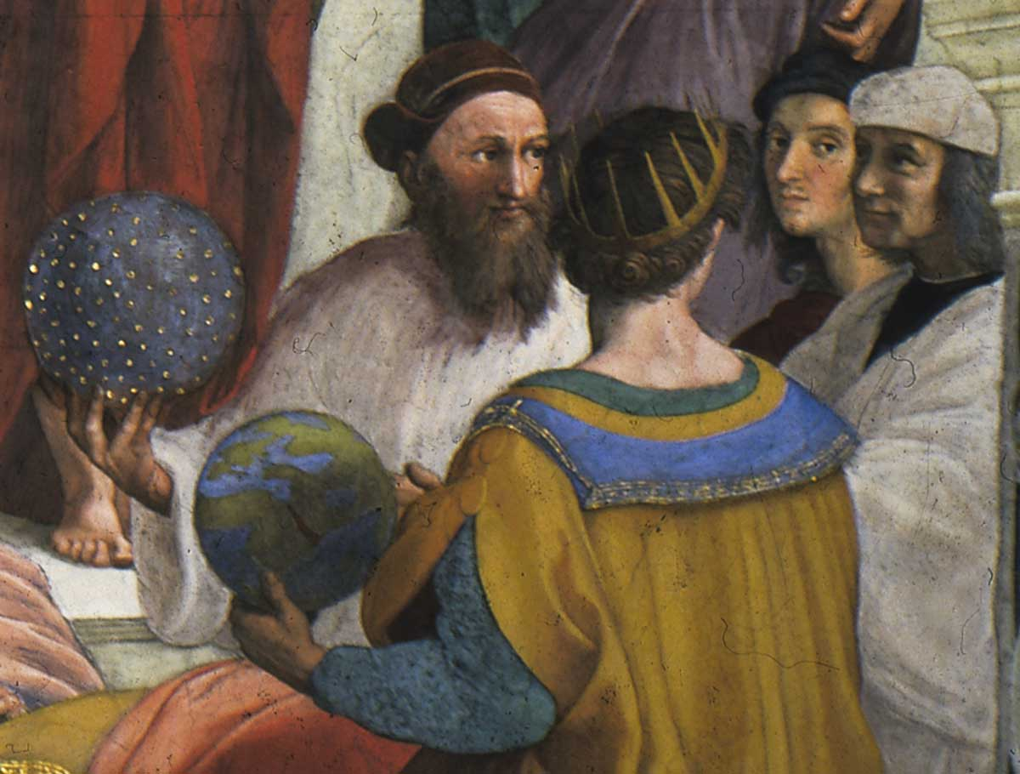

Slide 26
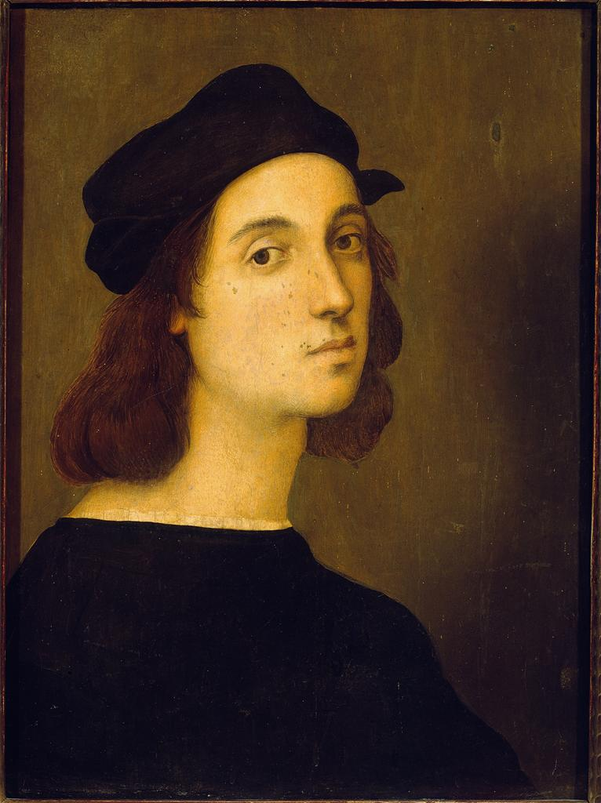
Raphael, Self-Portrait, 1509

Slide 27
Disputa (Theology)

Slide 30
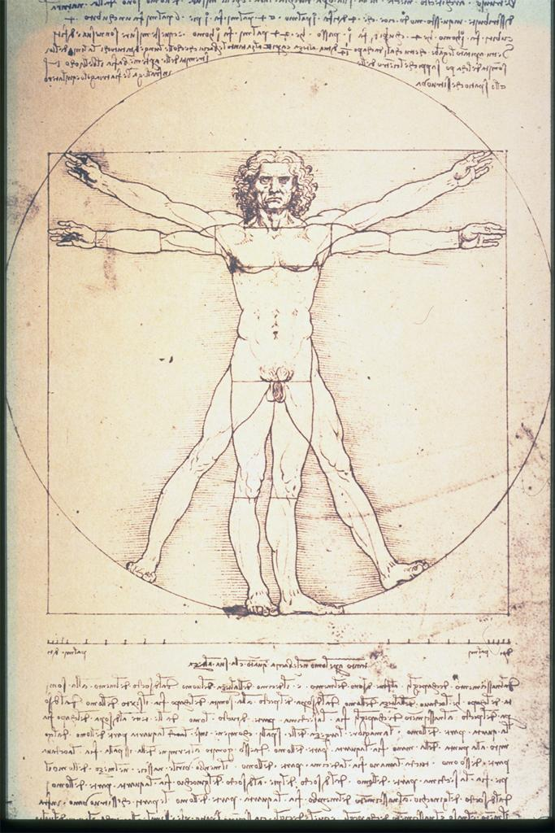
Leonardo da Vinci
Vitruvian Man
c. 1485-90

Slide 31
“Raphael’s fresco registers both a moment of classical perfection and its incipient
disintegration, as it figures, quite literally (and precociously), a fundamental shift
in the Renaissance conception of the artist and his art”
- David Rosand, p. 215

Slide 32
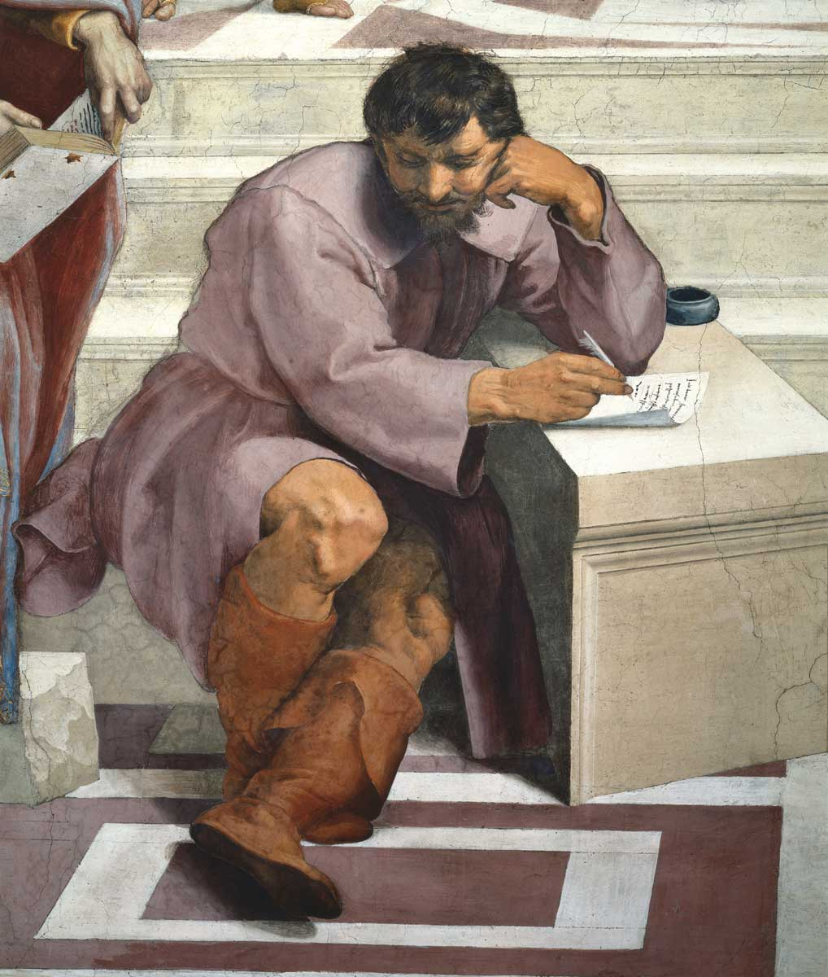

Slide 33
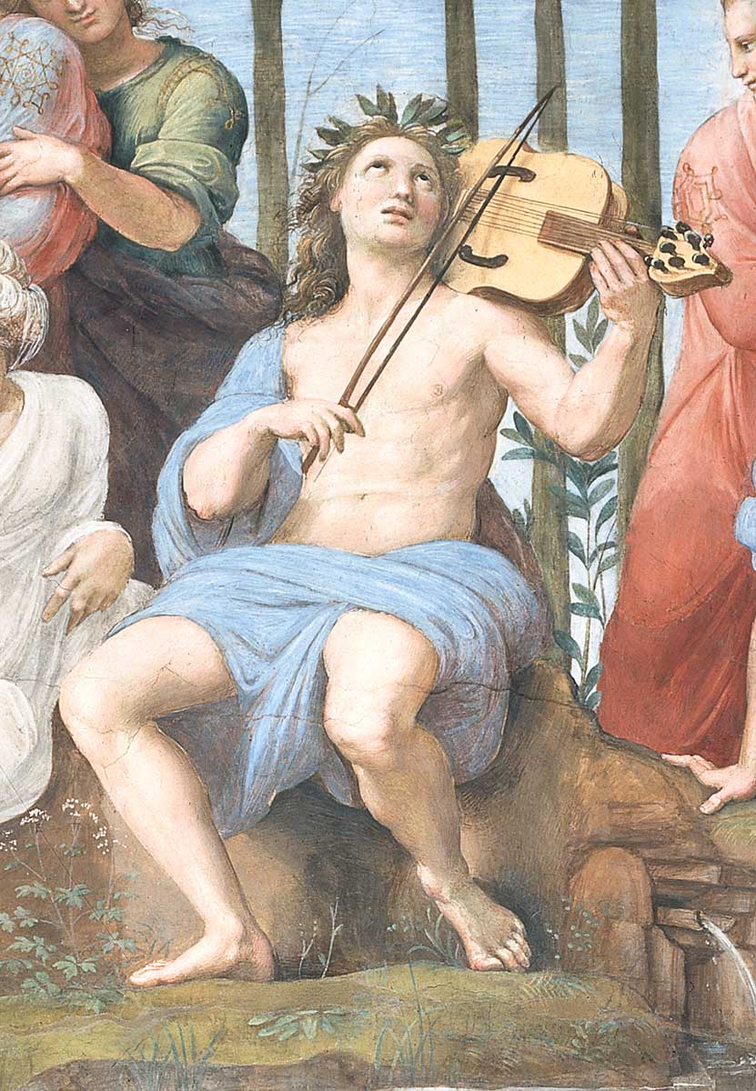
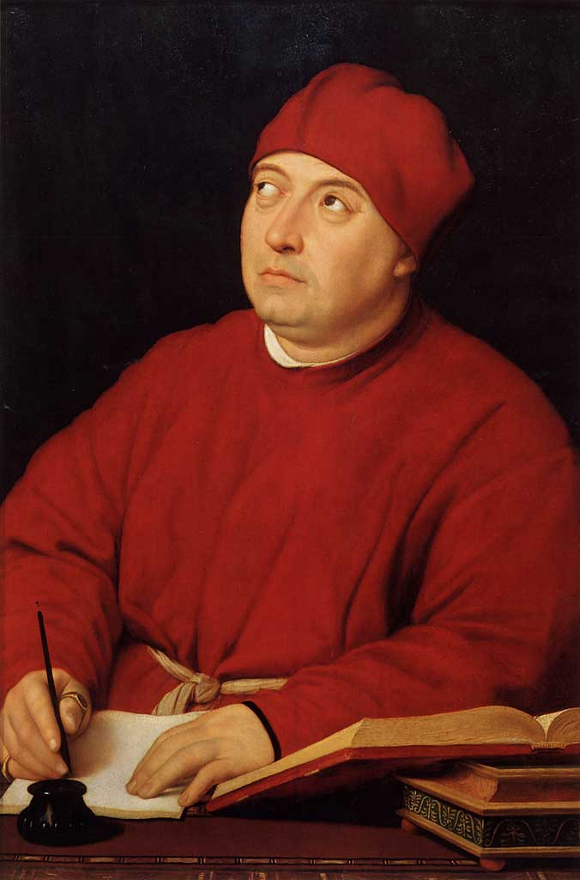
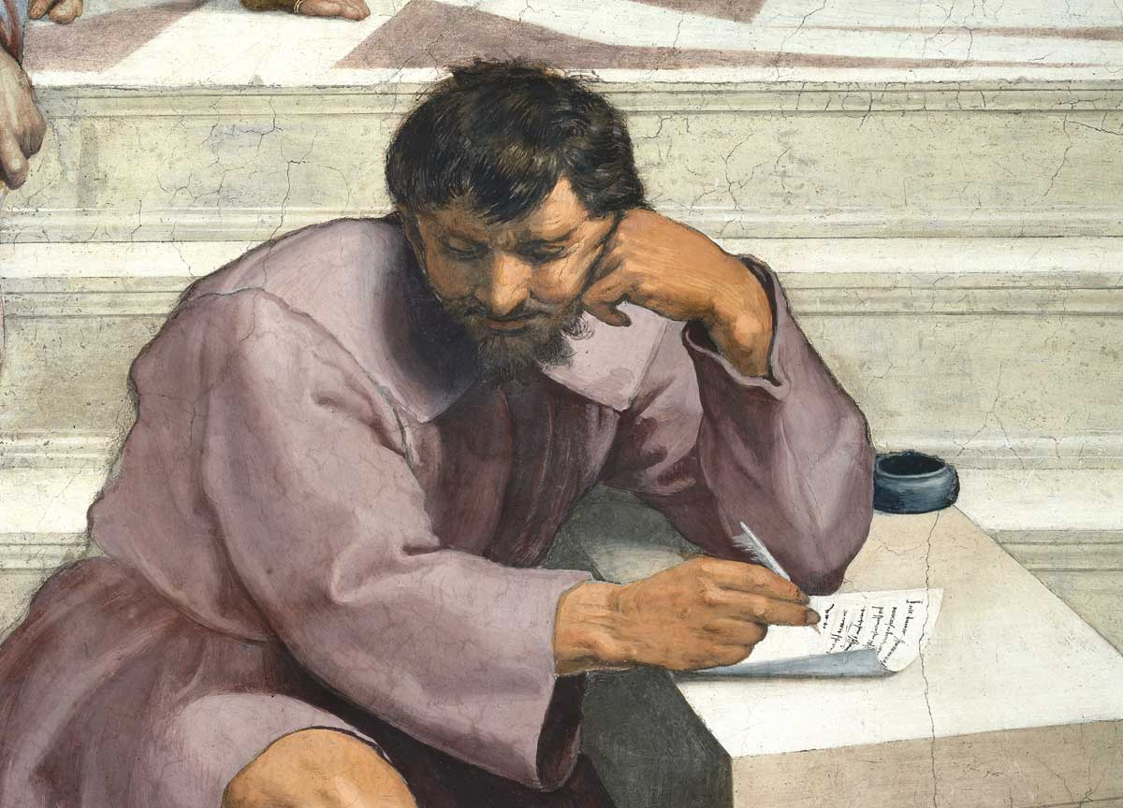
Raphael
Portrait of Cardinal
Tommaso Inghirami
c. 1510-1514

Slide 35
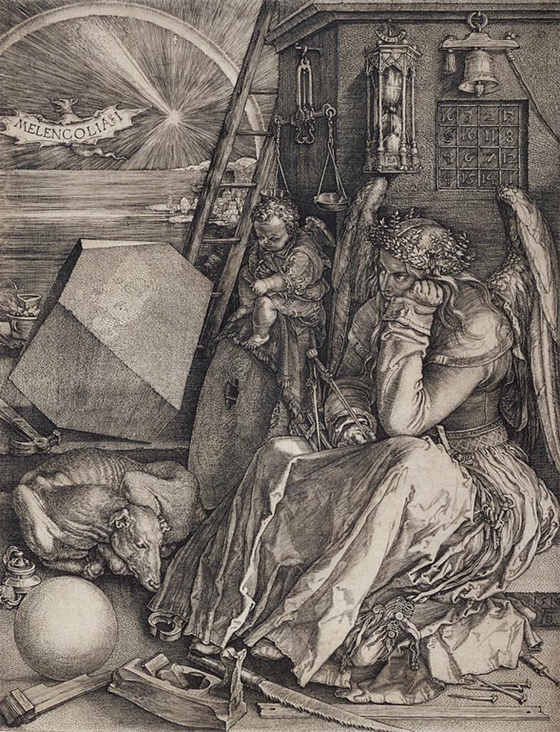
Albrecht Dürer
Melancholia I
Engraving
1514

Slide 36
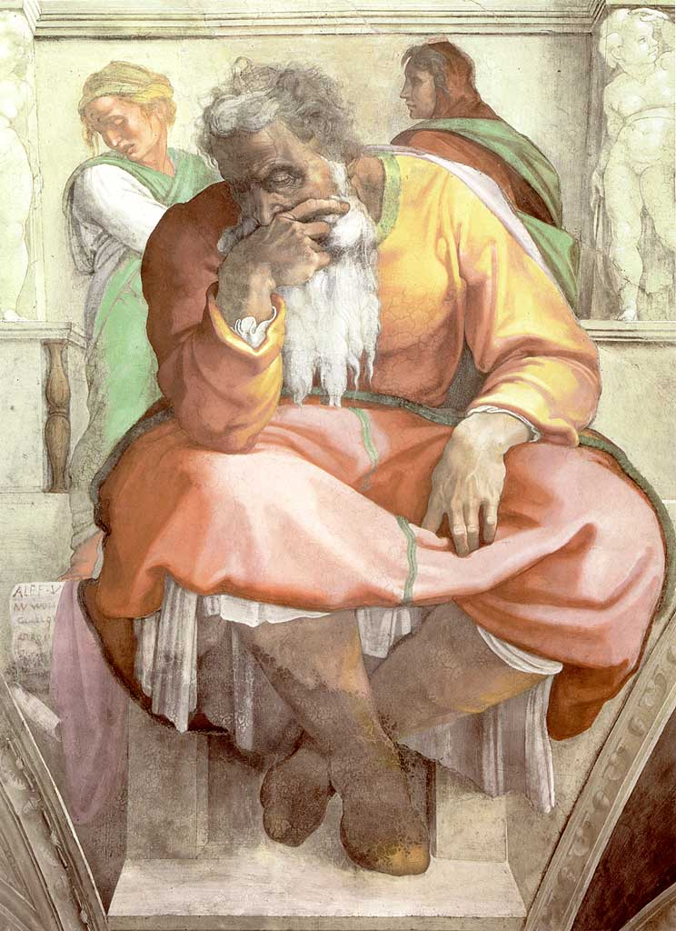
Michelangelo, Sistine Chapel Ceiling
Jeremiah

Slide 37
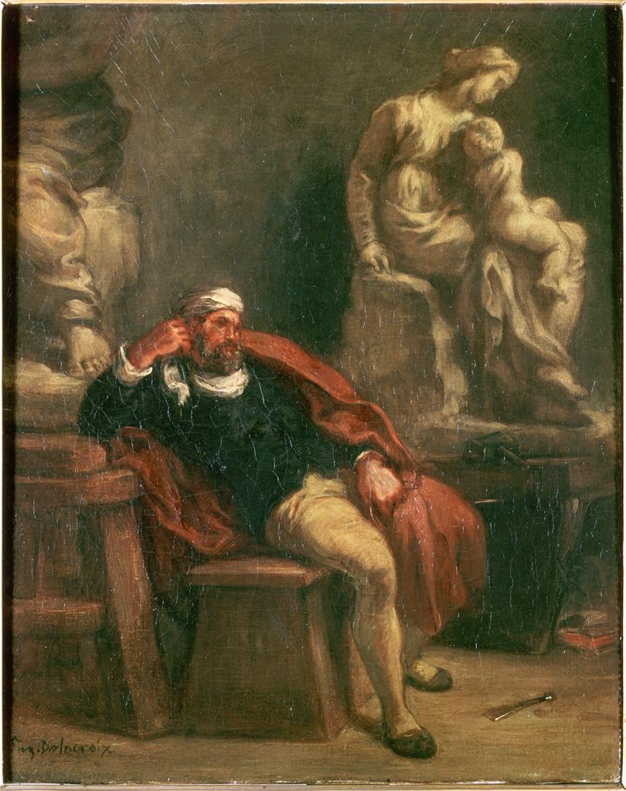
Delacroix
Michelangelo in his Studio
c. 1850

